Slide 1
How can we increase revenue
from
Catch the Pink Flamingo?
IGOR F. YAGO

Slide 2
Problem Statement
How can we use the following data sets to understand options for increasing revenue from game players?
Notes:
Fill in appropriate/key data set descriptions.
In your script, be sure to make clear how this is a data science story. State in your own words YOUR opinion of why the different kinds and sources of data are so important for Eglence to be able to identify new revenue opportunities.

Slide 3
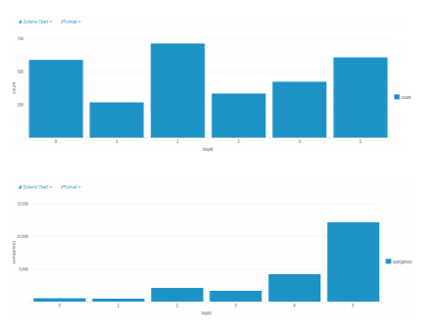
Data Exploration Overview
• item “2” is the most purchased, the item “1” is the least purchased
• tem “5” made the most money, and the item “1” made the least money
Notes:
Assuming you have <2 minutes for this slide, what is the most important thing(s) to convey from your experience with exploring the data?

Slide 4
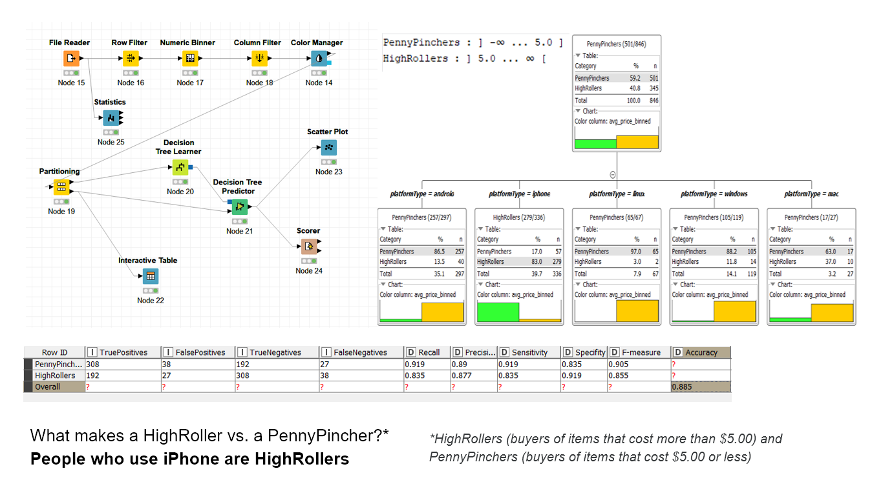
What have we learned from classification?
Notes:
Assume you have 2 minutes to present what you perceive to be the most important or remarkable points from your classification analysis.

Slide 5
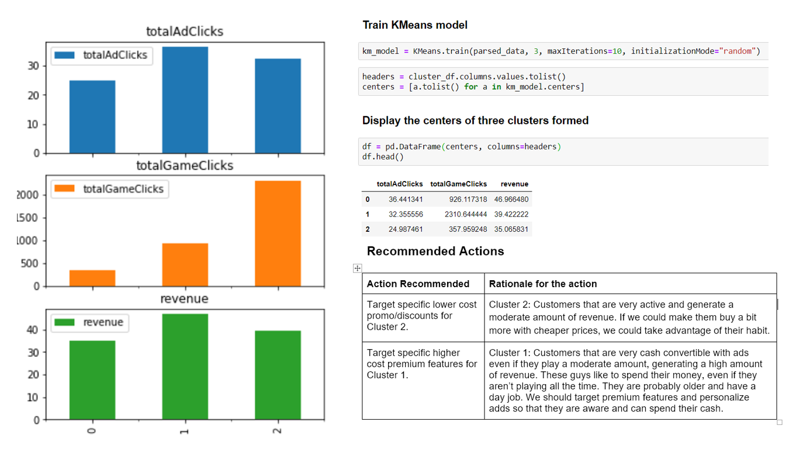
What have we learned from clustering?
Notes:
Assume you have 2 minutes to present what you perceive to be the most important or remarkable points from your classification analysis.

Slide 6
From our chat graph analysis, what further exploration should we undertake?
Find and target all influencers:
If we can identify these highly interactive neighborhoods, we can potentially target some members of the neighborhood for direct advertising. These will influence the rest on buying the same products.
Notes:
Assume you have 2 minutes to present what you perceive to be the most important or remarkable points from your graph analysis

Slide 7
Recommendation
• Offer more products to iPhone users
• Provide more products to “high level spending user”
• Provide some fixed pay packages or promotion to users, especially to “low level spending user”
• Target influencers that will spread the word of our products
Notes:
From your own viewpoint, make one recommendation/action the Eglence should follow to improve their business. Be sure to explain your rationale.

